Slide 1
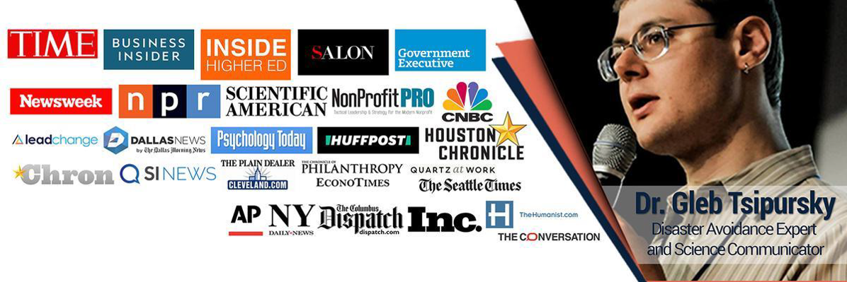
Outstanding Association Leadership Through Social Intelligence
Dr. Gleb Tsipursky, CEO, Disaster Avoidance Experts
DisasterAvoidanceExperts.com

Slide 2
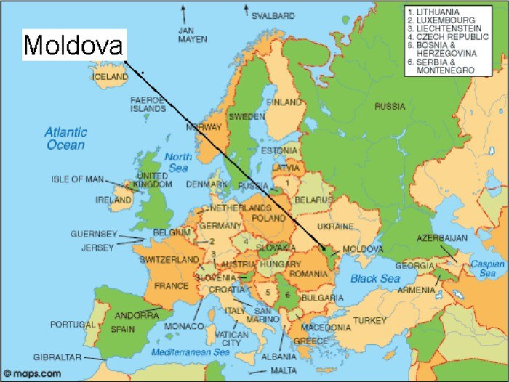
Where Are You From?
Accent discrimination
False perception of being less trustworthy

Slide 3
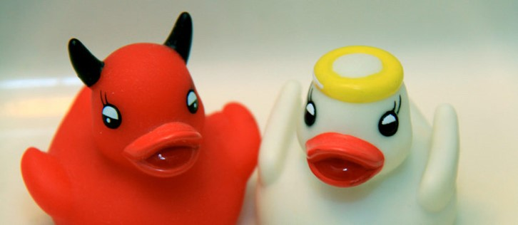

Horns Effect and Halo Effect
Horns Effect
  Dislike one characteristic
  Too-negative view of other characteristics
Halo Effect
  Like one characteristic
  ➔ Too-positive view of other characteristics

Slide 4
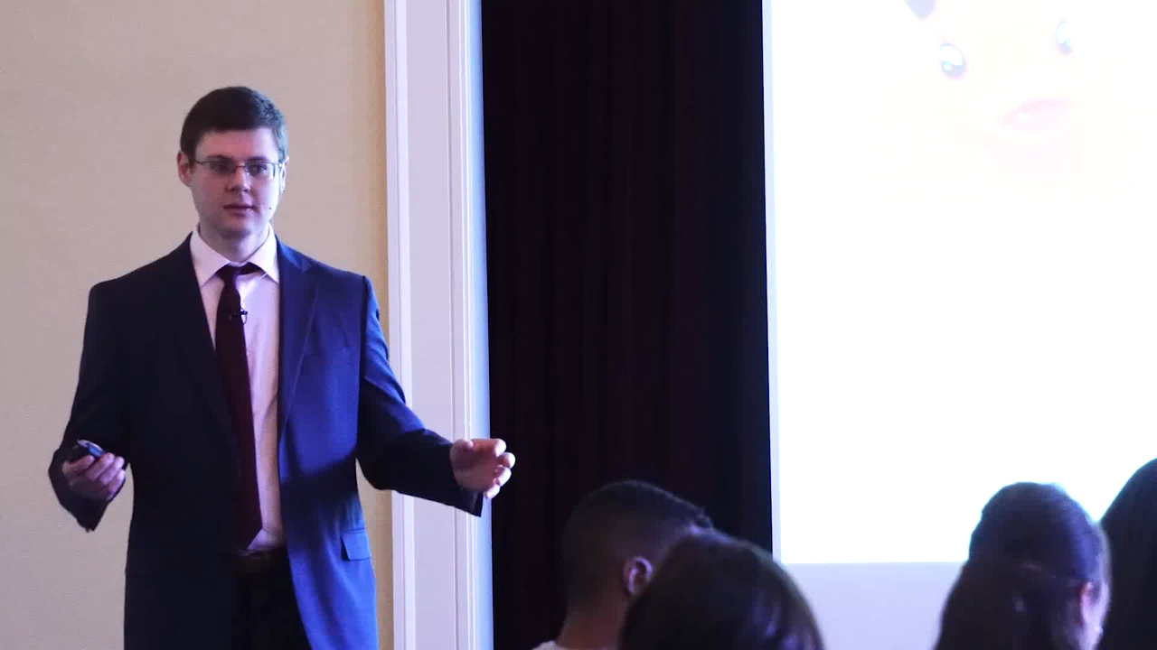

Slide 5

EGRIP (from my ASAE Associations Now article)
E: Emotions
G: Goals
R: Rapport
I: Information
P: Positive Reinforcement

Slide 6
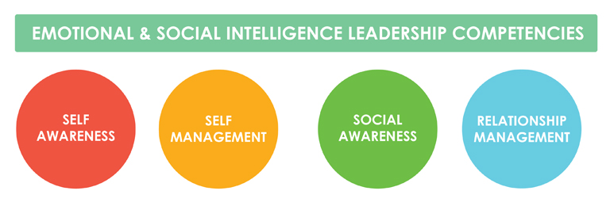
Emotional Intelligence vs. Social Intelligence

Slide 7
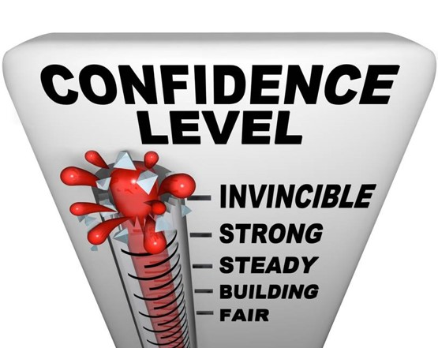
Be Confident!
Are you an above-average driver?
Overconfidence bias
Our tendency to be way too confident
If people are 100% confident
They are right about 80% of the time
Especially dangerous for experienced association leaders

Slide 8
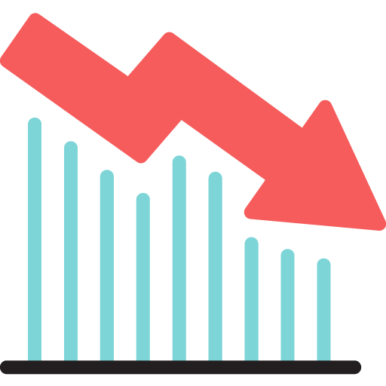
Retention Rate Blues
How happy are you with your new member retention?
Association Management Software (PropFuel & others)
Surveys based on member lifecycle
25-33% response rates on check-ins
AI sentiment analysis feedback
Automatically identifies issues
Such as new member engagement
Individual outreach to members
That need personal attention

Slide 9
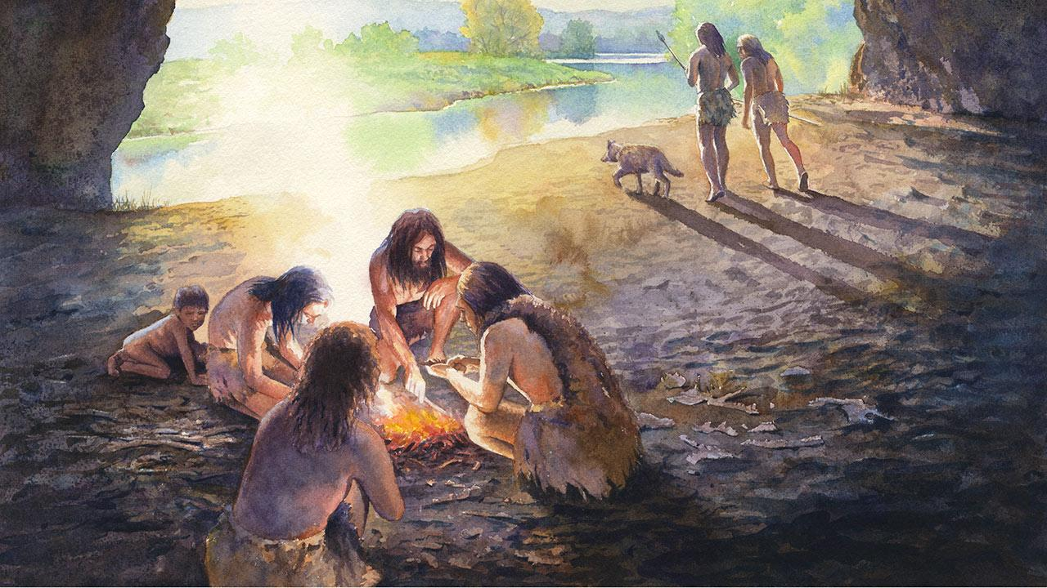
Our Evolutionary Heritage
Ancestors survived due to
Fight or flight response
Strong tribalism
Basic instincts good fit for savanna
Bad for modern professional environment
“Gut reaction” is fuzzy concept
Combines healthy learned behaviors
Dangerous intuitive ones
Always check with your head
Before going with your gut

Slide 10
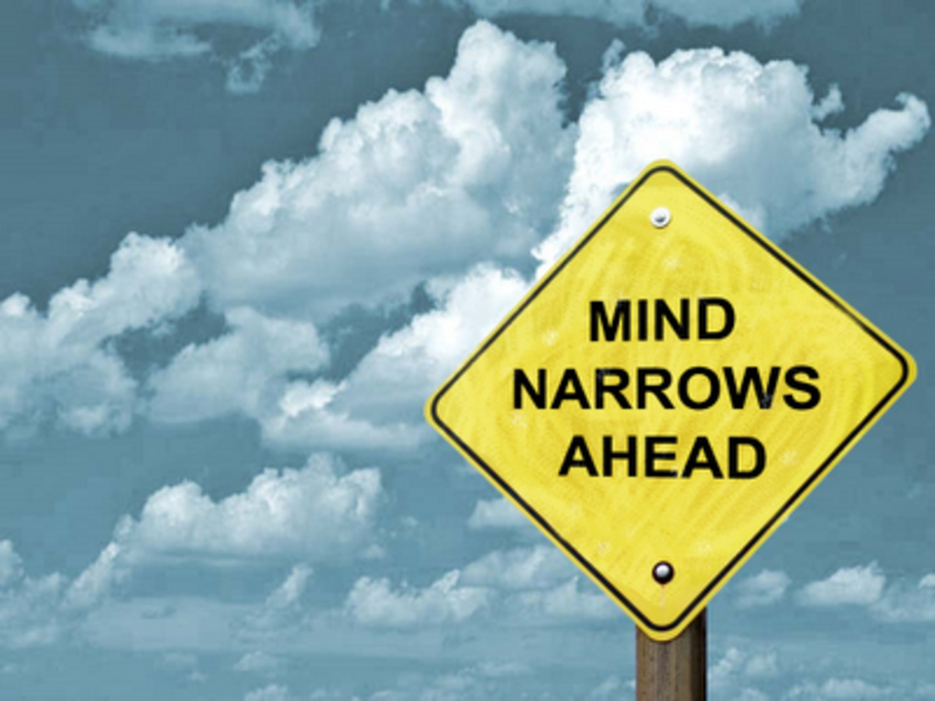
Beware Dangerous Judgment Errors (Cognitive Biases)

Slide 11

Keys to Dealing With Dangerous Judgment Errors
1) Learn about and watch out for them
2) Integrate this knowledge into your association
3) Implement research-based approaches to address dangerous judgment errors

Slide 12
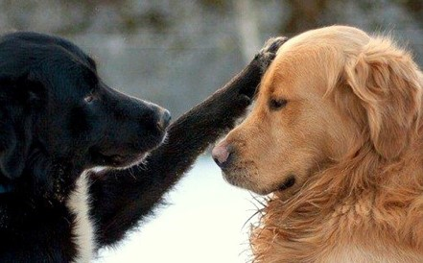
Who Cares?
Simply knowing about cognitive biases doesn’t fix them
People need to CARE
80-90% of behavior and decisions driven by emotions
Research shows to fix the errors we need to:
Identify where we fall into these mistakes
Recognize the pain caused from these errors

Slide 13
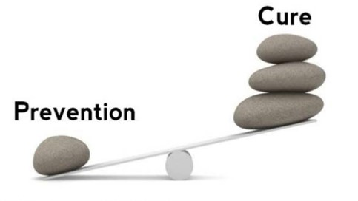
Avoiding Disasters
“Ounce of prevention worth pound of cure”
  ~Ben Franklin

Slide 14

Dr. Gleb Tsipursky’s
5 Key Questions for Avoiding Decision Disasters
What important information did I not yet fully consider?
What relevant dangerous judgment errors (cognitive biases) did I not yet address?
What would a trusted and objective adviser suggest I do?
How have I addressed the ways it could fail?
What new information would cause me to revisit the decision?

Slide 15
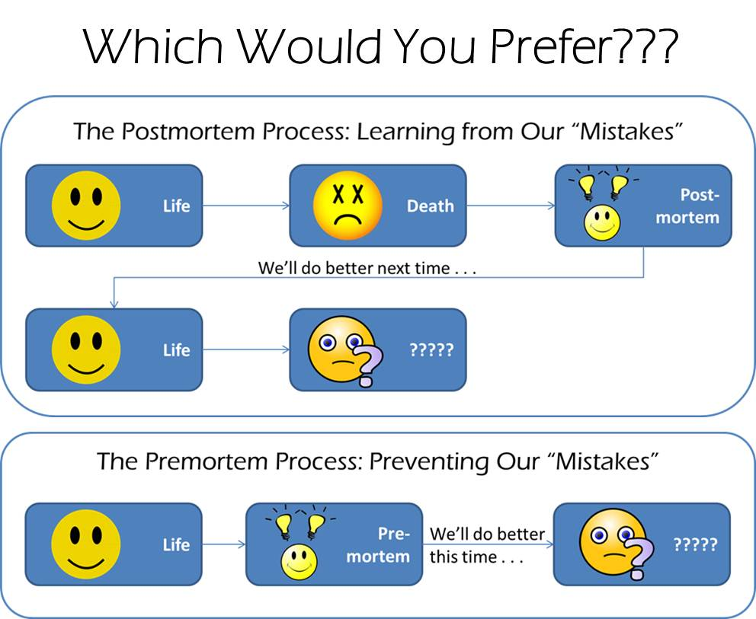
Failure-Proofing

Slide 16
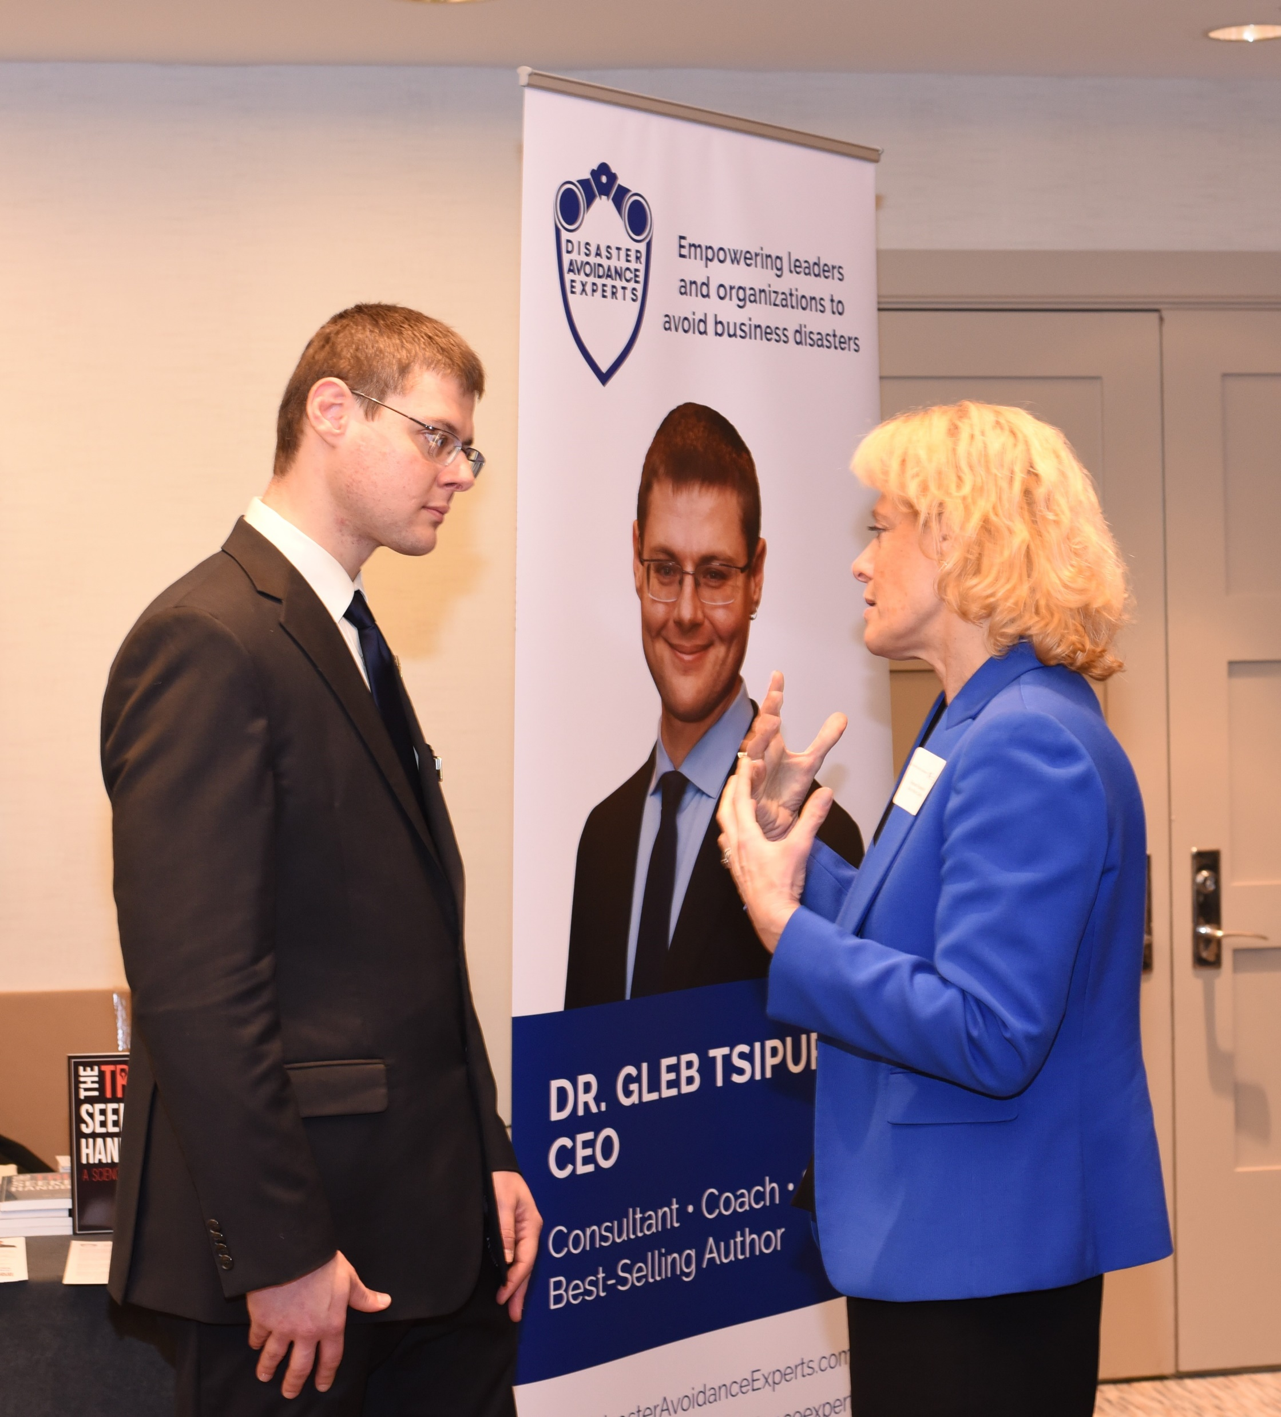
Free Resources to Support Integration
Downloads: tinyurl.com/ASAE2019
PowerPoint slide
Case study information
Outlines of techniques
Materials at back of the room
Case studies
Decision aids
Leave business card at back of room or talk to me
To get digital resource updates
To get hour of free coaching with me

Slide 17
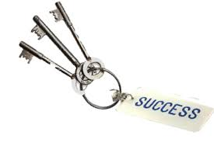
3 Key Take-Aways
Don’t Trust Gut, Check With Your Head
Watch Out for Dangerous Judgment Errors
Integrate Strategies to Address Dangerous Judgment Errors Into Your Association Team

Slide 18

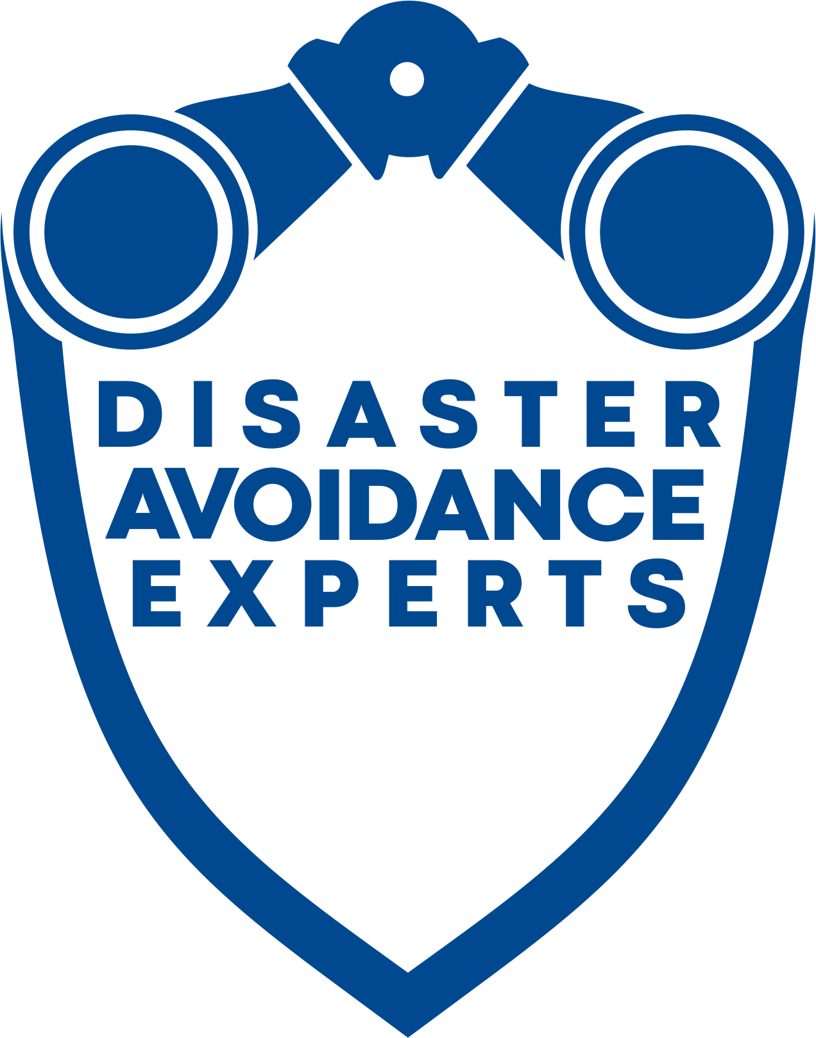

Your Social Intelligence
Will Empower Your Association to Flourish
In the next 12 months
Focus 25% on avoiding dangerous judgment errors
Benefits for you and your team
Less stress, frustration, and anxiety
Focus on core of your association work
Maximize member retention
What’s your story?
What kind of leader are you?
How will you integrate this paradigm shift?

